Slide 1
Presentation on CORE JAVA
Sachin Prajapati
B.tech (CSE)
3rd Year
IET BU JHANSI

Slide 2
Content
A brief history of java and overview of language
What is java?
Where is java used?
Features of java
How java works
Data Types in java
What is OOPs
OOPs Concept

Slide 3
A brief history of java
“Java whose originally named was OAK,was developed as GREEN PROJECT at sun micro system”

Slide 4
What is java?
Java is Object oriented Programming language
Java is Developed by James Gosling at sun microsystem
Now days java is adopted by oracle
Java is platform independent
Open source plateform

Slide 5
Where is java used ?
According to the oracle 3 billion devices run on java
Desktop applications
Web application
Mobile
Embedded System
Games
Robotics

Slide 6
Features of java
Java is simple
Java is object oriented
Java is distributed
Java is robust
Java is interpreted and compiled
Java is secure
Java is portable
Java is multi-threded

Slide 7
How java Works
Java’s Platform independent achieved by the use of Java virtual machine(JVM).
JVM is like usual computer which translate high level language into machine level language.
Extension of java “ .java ”.
Java program compiled which produces a .class file for each .java files
The .class file contains Java bytecode.

Slide 8
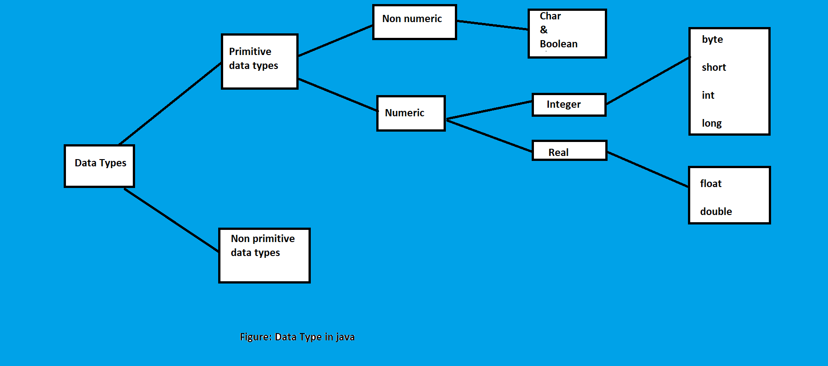
Figure on Data Types in Java

Slide 9
What is OOP?
A language in which everything is represent in form of object is called Object-oriented Programming language
Makes the software reuse feasible

Slide 10
OOPS Concept
Object
Class
Encapsulation
Inheritance
Polymorphism
Abstraction

